Slide 1

Final Project 2
Yeo ping En Charmaine

Slide 2
Setting the Scene
It’s time for Charlie to go to university!
She’s a smart cookie, so she can go to whichever university she wants.
She lives in Singapore, and prefers to enter a university closer to home.
2 main questions to answer:
Which country should she look for a Uni in?
Which factors should she look into if she wants to get a good quality education?

Slide 3
Cleaning the Data
Already rather clean:
No duplicates
Null values only for broad_impact in 2012, 2013, which appears to be a new factor introduced in 2014, so
Just have to note that there’re 2200 entries for 4 years. Meaning there are some years where there are more than 100 universities provided in data. Therefore, have extract the pertinent data and be careful when working with the entire dataframe.

Slide 4
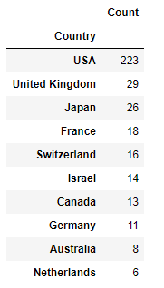
Top 10 Countries with Highest Count of Unis world ranked <=100.
USA has the most number of universities ranked top 100 in the world throughout the years 2012-2015.
Japan and Australia are the best countries if Charlie wants to remain closer to home (Singapore)

Slide 5
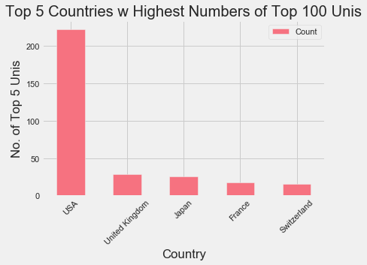
Which Countries to keep an eye on?
The majority of Top 100 Universities come from USA, who has about 8x more top 100 universities than the next best country: the UK.
The difference between the number of top 100 universities between the UK, Japan, France, and Switzerland is less drastic compared to the disparity between USA and UK.
With only integers, it's difficult to see if USA is the best place to go for a quality education because we should be using a percentage figure of: (Number of world_rank Top 100 schools / Total Universities in country) *100 to get a more accurate representation.

Slide 6
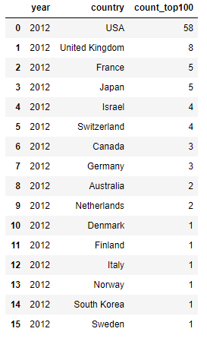
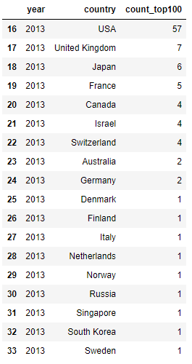
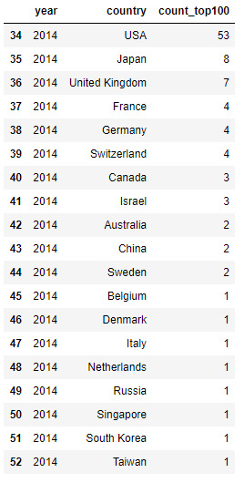
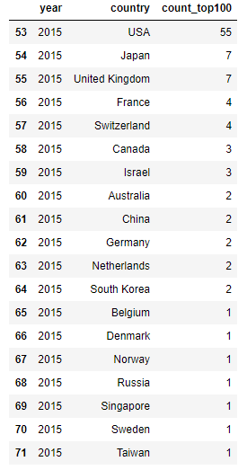
Countries w Unis in Top 100 by Year
+ Russia, Singapore
+ China, Taiwan, Belgium
+ Norway
- Finland, Norway
- Italy

Slide 7
Countries w Unis in Top 100 by Year
Interestingly, since 2012, more Asian countries (Singapore, Taiwan, China) have entered the Top 100 count, suggesting that there could be growing educational potential in some East Asian countries.
Not only that, there are also more universities within those countries that are entering the top 100 count. Japan saw an increase of universities from 5-7, reaching a peak of 8 unis in 2014, and has since displaced both France and the UK in 2015 since 2012, ranking as the 2nd country to have the highest number of universities in the top 100 count.

Slide 8
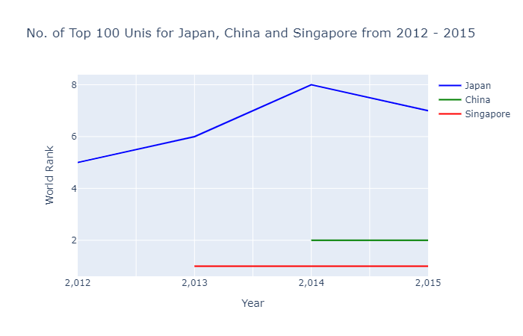
Comparing Unis Closer to Home
Singapore and China are relatively new players to the list, as compared to Japan, a more established country with more (5-8) universities in the top 100 list.
Japan is doing very well from 2012-2015, increasing from 5-7 universities and peaking at 8.
While Singapore made the list earlier in 2013 with 1 university, interestingly, China started out with 2 universities, albeit a little later in 2014. Maybe due to them being a larger country with more universities.

Slide 9
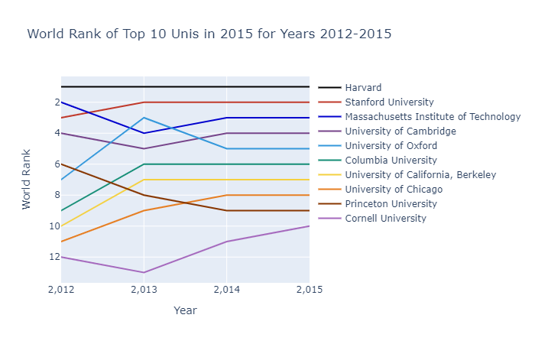
Examining 2015’s Top 10
8/10 from US.
Top, most constant: Harvard (1st place for all 4 years.)
Net decrease: MIT and Princeton
Net increase: The rest
Greatest net increase: University of Chicago
(3 places, from 11th-8th place).
Greatest net decrease: Princeton University
(3 places, from 6th-9th place.)
Greatest increase in a year: University of Oxford
(4 places, from 7th-3rd place)
Greatest decrease in a year: MIT, Princeton, and Oxford
(2 places within a year).
Interestingly, only 4/8 renowned Ivy League schools
(Harvard, Cornell, Princeton, Columbia) are within top 10.

Slide 10
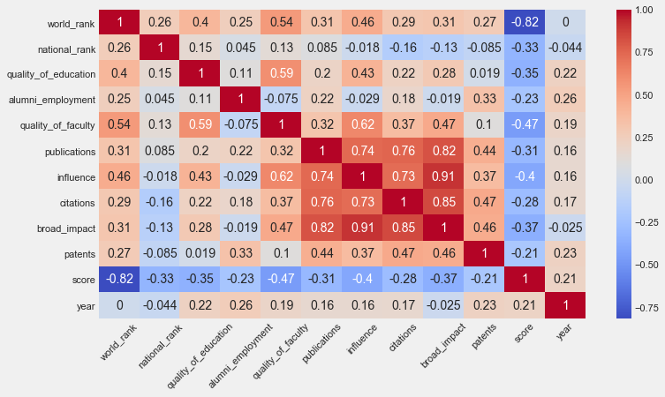
Factors correlating to World Rank
Quality of Faculty (0.54),
Influence (0.46)
Quality of Education (0.4)

Slide 11
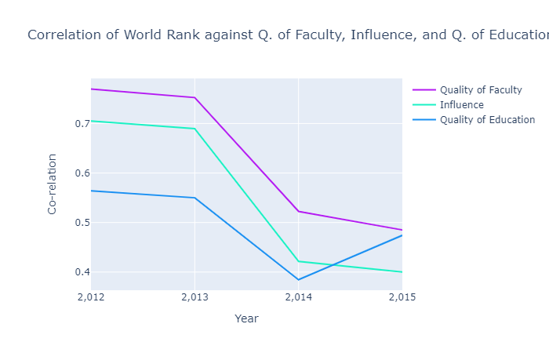
Factors correlating to World Rank
All 3 factors show a heavy downward trend, suggesting that they have become less correlated to world ranks as time progressed.
The heavy downturn comes after 2013, suggesting that CWUR might have adjusted the weightage for the three factors, or the introduction of broad impact might have caused the correlations to dip.
Influence was the most affected, decreasing around 50% in correlation between 2013-2015.
The only slight increase is the correlation for quality of education (2014-2015).

Slide 12
Points to Note:
!!! Very important to note certain inherent biases:
Data will always carry bias based on how they are obtained: For Eg. studies that are in different languages or translated into English may not be ranked highly in citations/ publication as those in English.
Universities will have different focuses. Need to examine further on how measures are calculated to find a good fit for Charlie.
!!! Other factor to consider:
Price point: Universities in the USA are highly ranked, but notoriously expensive. Unless Charlie gets a scholarship, she might not be able to afford it.

Slide 13
Last thoughts
Which country should she look for a Uni in?
If Charlie wishes to find a uni near home, she might want to look further into the Universities in Japan as the country appears to be very consistant in having established universities in the top 100.
However, if she wants to attend a prestigious world ranked top 10 uni, she’ll have to look to the USA and the UK.
Which factors should she look into if she wants to get a good quality education?
Quality of Faculty, Influence, and Quality of Education all appear to have the highest overall coorelation to world rank. However, they seem to be dipping in importance during the course of 2012-2015.
It might be worth looking for other factors such as broad impact to decide as preliminary findings suggest a high correlation to other factors like publication, citations, and influence. Need to determine if the correlation is due to causation.
Also, while the correlation between world rank and quality of education has decreased from 2012-2015, it is the only correlation of a factor that has increased, and thus may be worth looking into to see if it continues on an upward trend in following years.

